Slide 1
TANA WATER WORKS DEVELOPMENT AGENCY (TWWDA)
PRESENTATION ON TWWDA MANDATE IN THE WATER ACT 2016.
STAKEHOLDERS’ CONFERENCE FOR EMBE WATER AND SANITATION COMPANY HELD ON 18TH OCTOBER 2023.
PRESENTATION BY PHILIP MUTUA-TECHNICAL MANAGER EMBE WSP ON BEHALF OF TWWDA
TWWDA IS ISO 9001:2015 CERTIFIED

Slide 2
OUTLINE
INTRODUCTION
TANA WATER WORKS DEVELOPMENT AGENCY (TWWDA) MANDATE UNDER THE WATER ACT 2016
TWWDA’S INTERVENTION IN WATER & SANITATION SERVICES
WAY FORWARD

Slide 3
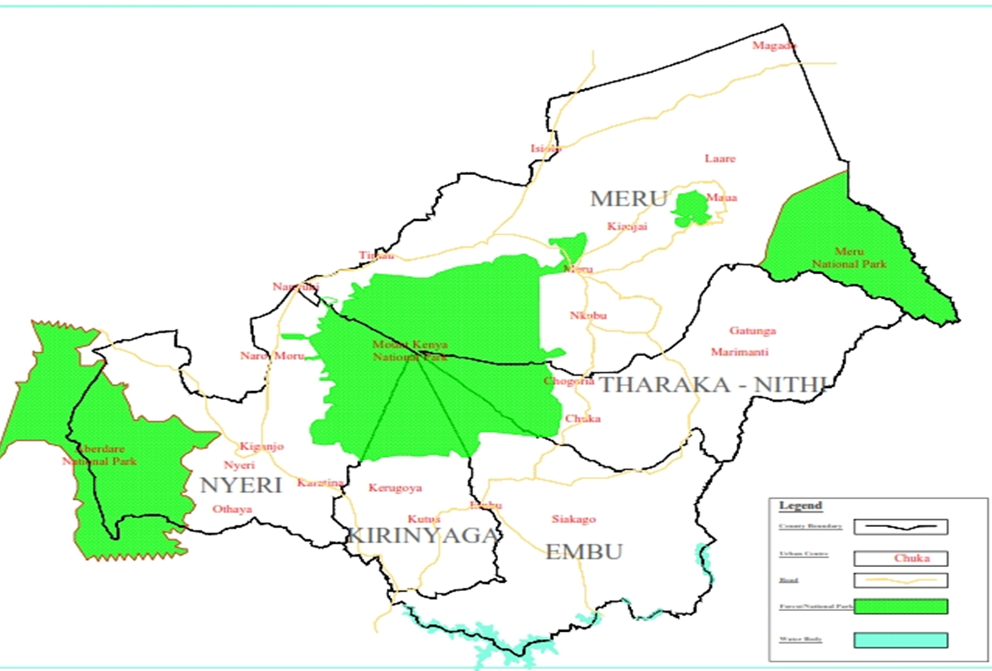
Tana Water Works Development Agency (TWWDA) is one of the nine (9) Water Works Development Agencies established through Legal Notice No. 28 of 26th April, 2019 in line with the Water Act 2016.
The geographical area of jurisdiction of the Agency is Embu, Kirinyaga, Meru, Nyeri and Tharaka Nithi counties covering an area of 17,193 km² with a population of 3,960,222 (Kenya Population and Housing Census, 2019).

Slide 4
TWWDA MANDATE
The Agency derives its mandate from the Water Act 2016 clause 68 as follows:
a) Undertake the development, maintenance and management of National Public Water Works within its area of jurisdiction
b) Operate Water Works and provide water services as a Water Service Provider until such a time as responsibility for the operation and management of the waterworks are handed over to a county government, joint committee, authority of county governments or water services provider within whose area of jurisdiction or supply the waterworks is located;

Slide 5
TWWDA Mandate
c) Provide reserve capacity for purposes of providing water services, where pursuant to section 103, the Regulatory Board orders the transfer of water services functions from a defaulting water services provider to another licensee;
d) Provide Technical Services and Capacity Building to County governments and WSPs in their area of jurisdiction as may be requested.
e) Provide Technical Support to the Water Cabinet Secretary in discharge of his or her functions under the Constitution and this Act.

Slide 6
TWWDA’S INTERVENTION IN WATER&SANITATION SERVICES
Technical Services and Capacity Building
As we discharge the mandate on Technical Services and Capacity building , the Agency has undertaken the following :-
Provision of Non Revenue Water Management (NRWM) Equipment and training on NRWM.
Facilitated the WSP’s interactions with the Water Police Unit an initiative of the Ministry of Water, Sanitation and Irrigation and the Ministry of Interior and Co-ordination of National Government (National Police Service)

Slide 7
TWWDA’S INTERVENTION IN WATER&SANITATION SERVICES
for collaboration with Unit on areas of concerns for example water services installations security, vandalism on water and sanitation infrastructure and Non Revenue Water Management.
4.Coordinated and facilitated the Water Police Unit during the unit’s operations in Ena-Siakago and Ishiara Water Schemes
5. Invitation in the following trainings organized by the Agency for Agency staff and WSPs
Alcohol and Drugs / Substances abuse prevention ,treatment and rehabilitation
HIV, Mental Health ,non-communicable diseases &Nutrition
c) Citizen Service Delivery Charter

Slide 8
TWWDA’S INTERVENTION IN WATER&SANITATION SERVICES
d) Non Revenue Water Management
e) Road Safety, Testing ,Prevention and Care for HIV/AIDs. ICT security (FY 2021/22 )
f) Attendance of Stakeholder forums and Annual General meetings

Slide 9
TWWDA’S INTERVENTION IN WATER&SANITATION SERVICES ON GOING PROJECT – ENA SIAKAGO WATER SUPPLY PROJECT

Slide 10
WAY FORWARD
Prompt reporting in the Monthly Monitoring and Evaluation on Water Services
Continued collaboration, partnerships and information sharing for effective service delivery to the people of Mbeere North Sub-County

Slide 11
Thank You for your attention
Quality Water Works for Improved Livelihood

